Slide 1
Big Data & GIS
14011104 윤호준

Slide 2
Contents
What is Big Data?
Characteristic of Big Data
Big Data’s process & analysis
Big Data & GIS
Big Data as an Alternative Visualization tool for GIS

Slide 3
1. What is Big Data?
Big Data is the term for a collection of data sets so large and complex that traditional data processing applications are inadequate to deal with them.

Slide 4
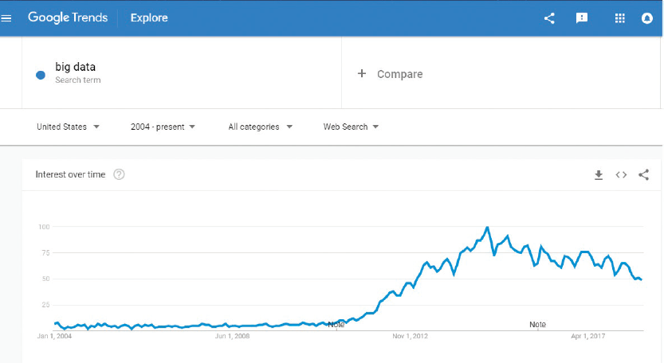

Slide 5
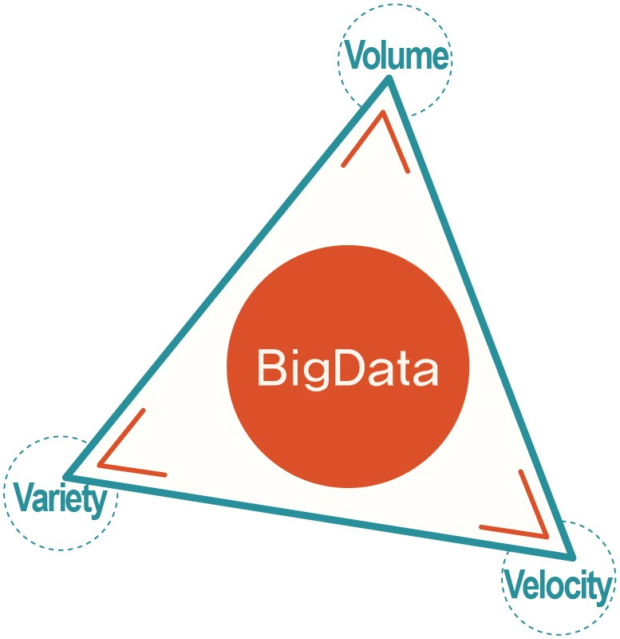
1. What is Big Data?
Characteristic of Big Data
Volume
Variety
Velocity

Slide 6
2. Characteristic of Big Data
Volume
- Big Data deals with large volume datasets, usually more than terabyte size.

Slide 7
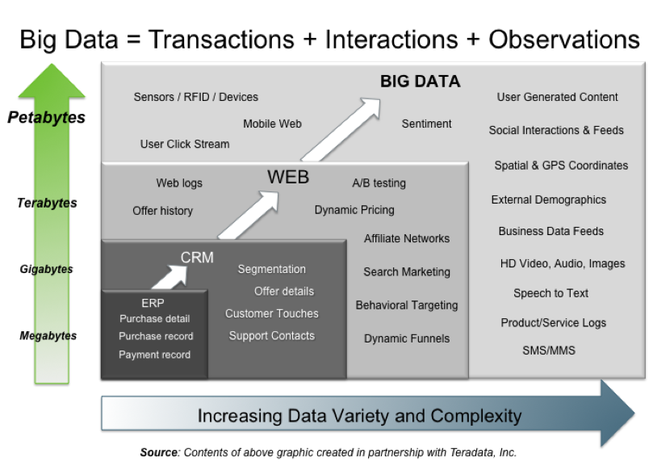
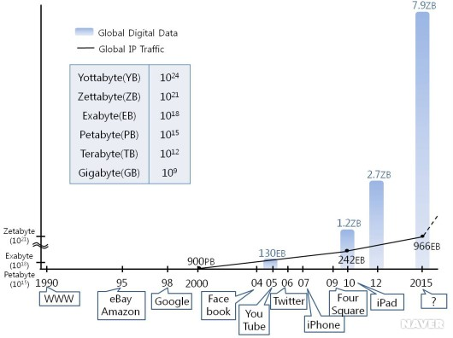

Slide 8
2. Characteristic of Big Data
Variety
Big Data deals with a variety of datasets
ex) Sound, Picture, Video Stream, Map, Social Media Text Message etc.

Slide 9

















Social Media
Banking
Finance
Gaming
Our
Known
History
Customer
Entertain
Purchase

Slide 10
2. Characteristic of Big Data
Velocity
Data is generated fast and need to be processed fast

Slide 11
3. Big Data’s data process & analysis

Slide 12
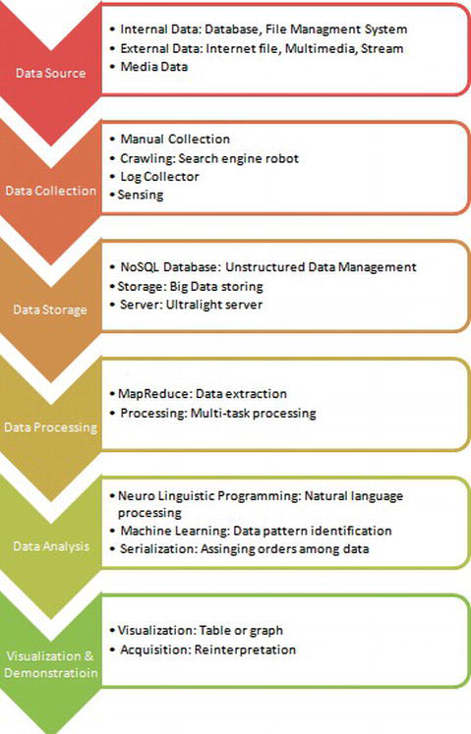

Slide 13
Big Data’s Process & Analysis
Data Source
Big Data sources come from institution’s or organization’s internal DB, or external DB such as Facebook, Twitter or pictures & video streams.
Data Collection
Big Data utilizes a crawling method with search engine to get Internet Data.(Also uses IoT based sensors to collect data)
This step makes a huge difference to Big Data from the past data collection traditions.
Data Storage
Step that engineering technologies are concentrated.

Slide 14
Big Data’s Process & Analysis
Data Processing & Analysis
Researchers use programming for natural language processing, machine learning for data pattern identification & serialization for assigning orders among data.
Data Visualization & Demonstration
Process that analyzed datasets are expressed with graph or table format.
R, Python languages are getting a new attention as effective visualization tool for Big Data demonstration.

Slide 15
4. Big Data & GIS

Slide 16
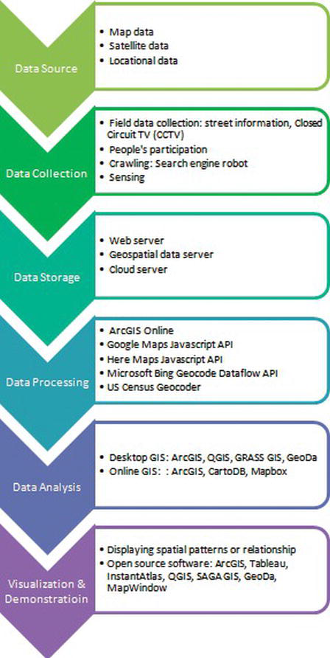

Slide 17
Big Data & GIS
Data Source
GIS uses data that contains a location or space, so it is displayed in a map or picture form.
As a location based data, GIS data is usually large-sized as is Big Data.
Data Collection
GIS collects field data such as street information, CCTV, or other location based datasets.
Data Storage
GIS has web server, geospatial data server, or cloud server for its data storage.
These servers can be overlapped one another sometimes, but they have their own territories that cannot be shared.
In ESRI’s official website information, GDB(Geodatabase) system is crucial to manage complicated structured GIS datasets and their attributes.

Slide 18
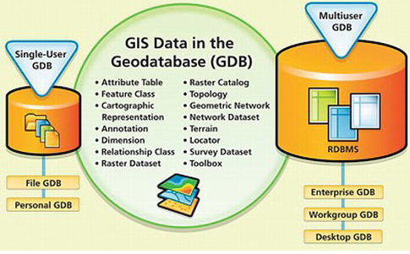
GIS Data in the GDB

Slide 19
Big Data & GIS
Data Processing
GIS desktop and online software plays a crucial role in the rest of process including data processing, analysis and visualization
Like ArcGIS Online and Google Maps JavaScript API, these software include efficient systems.
Data Analysis
GIS data analysis contains several functions such as Extract, Overlay, Pairwise Overlay, Proximity and Statistics.
Similar analyses are conducted with GIS systems.(ArcGIS, QGIS, GeoDa etc.)
Data Visualization & Demonstration
GIS data visualization intends to display spatial patterns or relationship between or among locations.

Slide 20
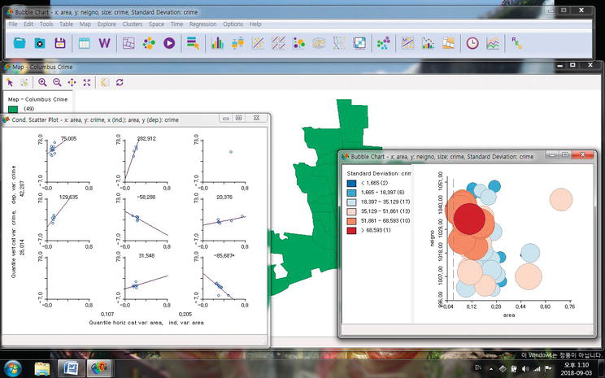
Visualization in GeoDa

Slide 21
5. Big Data as an Alternative Visualization tool for GIS

Slide 22
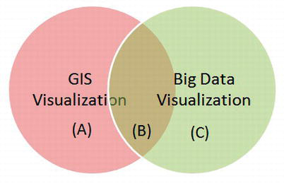
Big Data as an Alternative Visualization tool for GIS
In the visualization and demonstration technology, Big Data and GIS share together in some aspects.
But, there is each field’s original aspect that cannot be shared or come together.

Slide 23
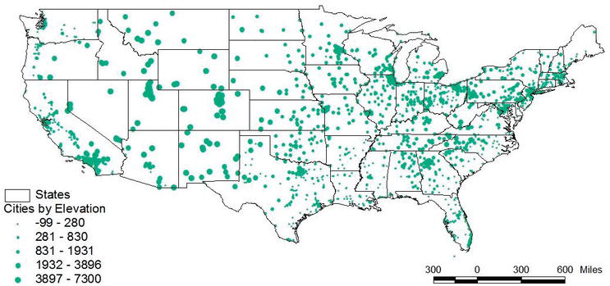
Example of area (A)

Slide 24
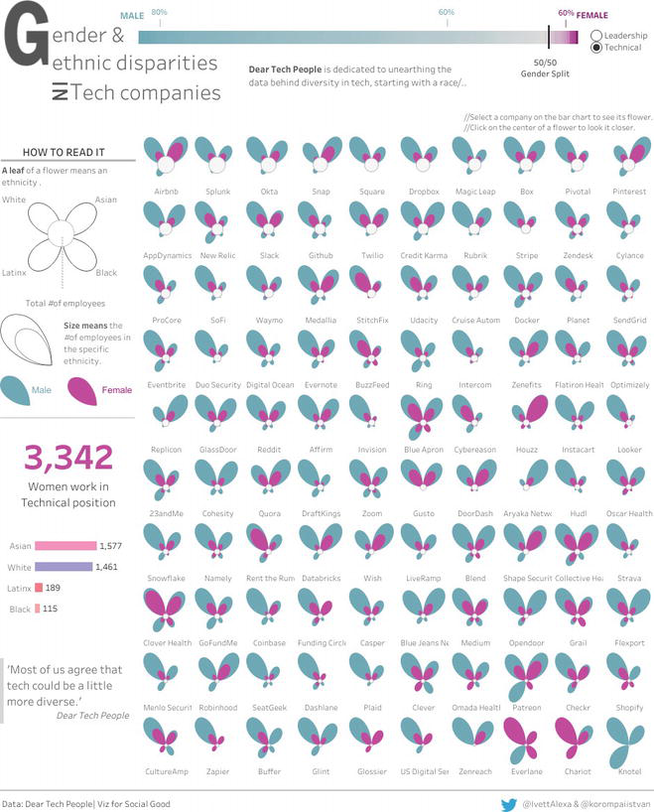
Example of area (C)

Slide 25
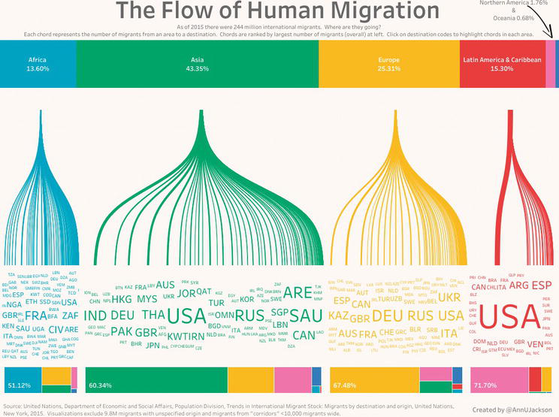
Example of area (B)

Slide 26
Thank you for listening

